Slide 1
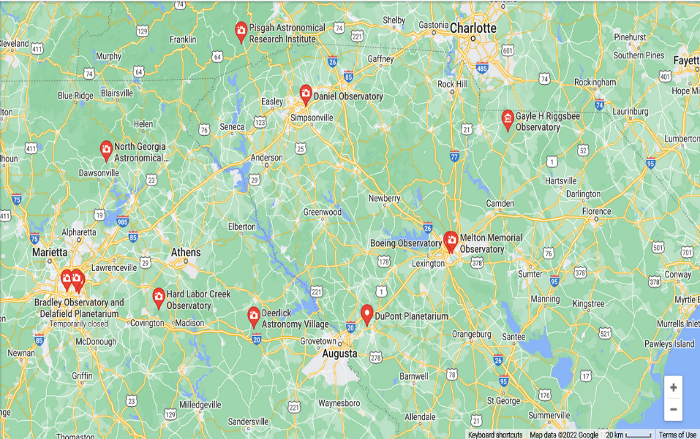
“Local” Observatories
UGA Observatory
Boyd Pond Observatory

Slide 2
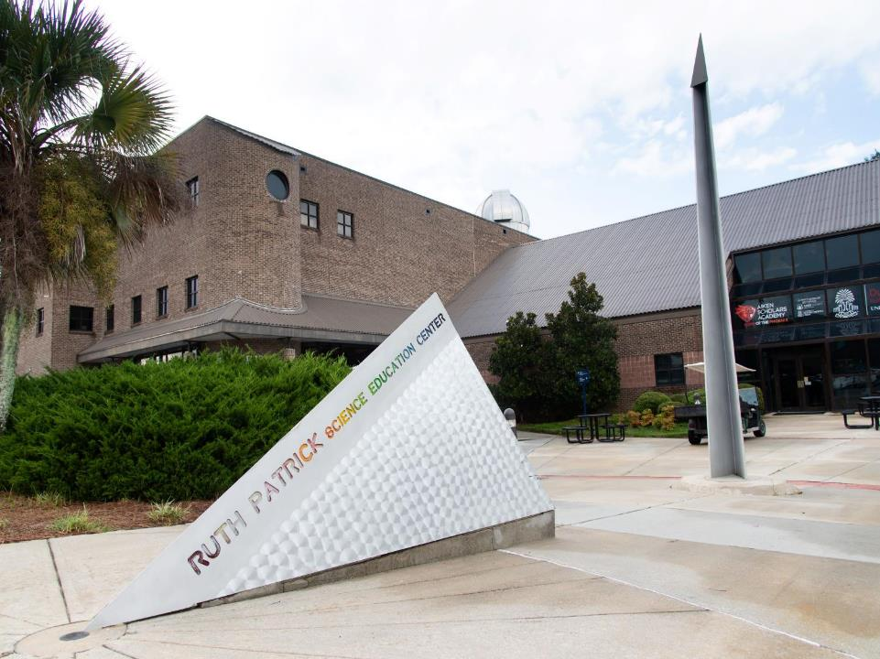

Slide 3
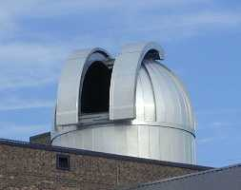
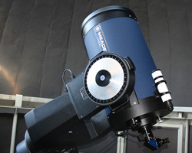
The observatory building was manufactured by Observadome in Jackson, Mississippi. It is five meters in diameter and has a rotating domed roof.
The Bechtel Telescope is a 16 inch, Meade LX-200GPS, Schmidt-Cassegrain, catadioptric telescope.
Visit the Bechtel Telescope after evening public planetarium shows. The observatory is open after regularly scheduled planetarium shows on Saturday evenings; weather and dark skies permitting.
Also houses the Dupont Planetarium
Ruth Patrick Science Education Center
471 University Pkwy Aiken, SC 29801
Phone803-641-3313
https://www.usca.edu/rpsec/

Slide 4
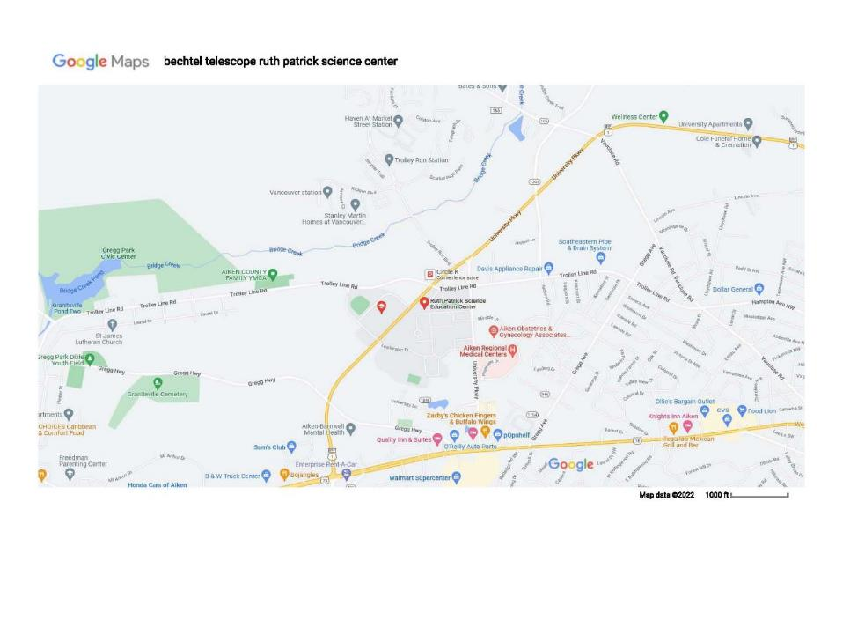

Slide 6
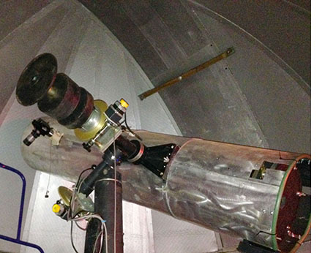
Boyd Observatory is open ( weather permitting ) on the first and third Friday of the month
PROGRAMS START AT SUNDOWN. PLEASE ARRIVE EARLY.
Please email David Boyd if you plan to visit.
dboyd@boydobservatory.com
The Observatory Telescope is a
444 mm (17 ½”) F 4.5 Newtonian Reflector
Boyd Pond 373 Boyd Pond Road Aiken SC, 29803

Slide 7
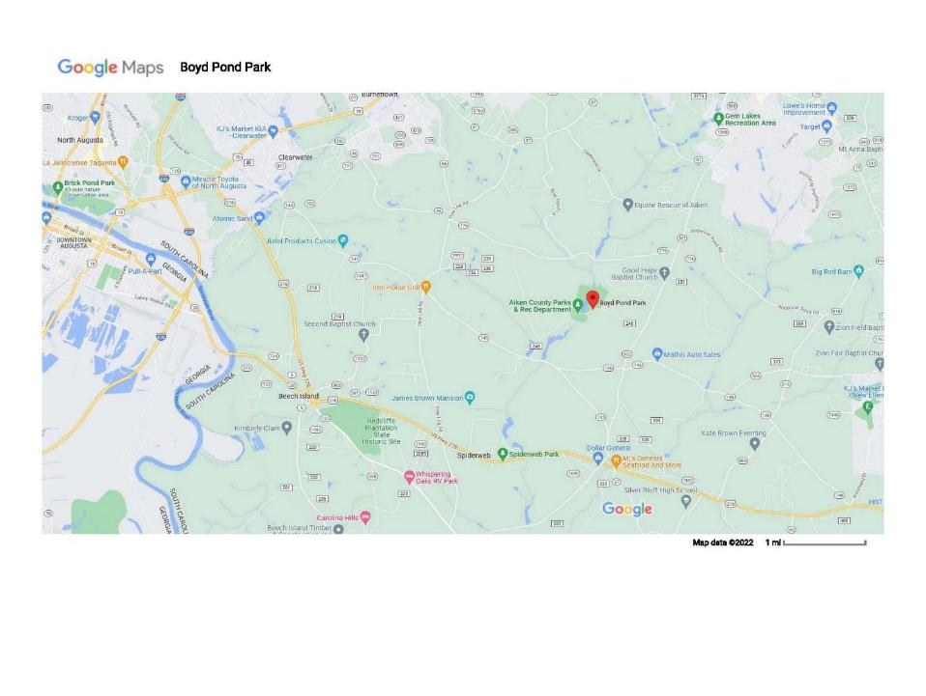

Slide 8
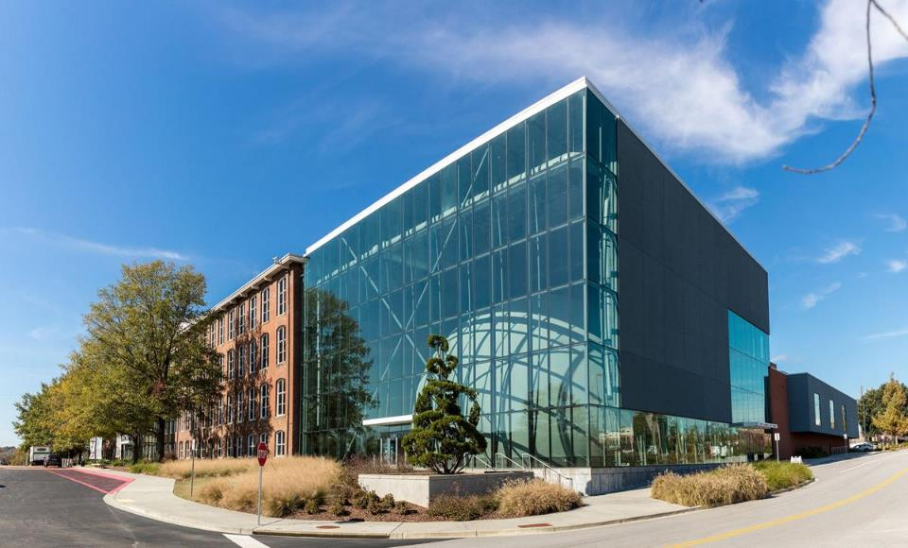
The South Carolina State Museum
Includes the Boeing Observatory and BlueCross BlueShield of South Carolina Planetarium
http://scmuseum.org/
Museum Information: 803-898-4921
Guest Services: 803-898-4978
301 Gervais Street Columbia, SC 29201

Slide 9
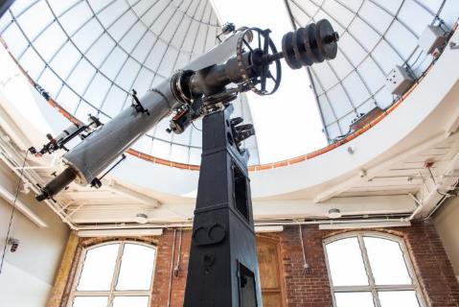
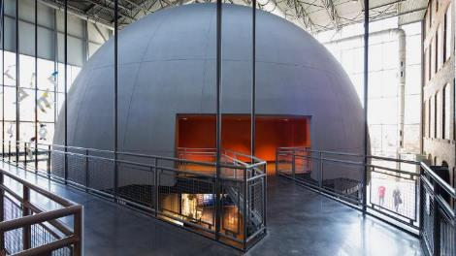
Boeing Observatory
This 2,500 square foot observatory at the South Carolina State Museum features a 1926 Alvan Clark 12 3/8-inch refracting telescope, outdoor viewing terrace, and adjoining classroom.
Solar Observing
Mon: Closed Tues. – Fri: 12 to 4 p.m. Sat: 12 to 5 p.m. Sun: 1 to 5 p.m.
Night Observing
Currently Closed Until Further Notice
Questions? Contact Observatory Manager, Matthew Whitehouse, at 803.898.4918 or email at matthew.whitehouse@scmuseum.org
Museum Hours
Sun.: 12 - 5 p.m. Mon: Closed Tues. - Fri: 10 a.m. - 5 p.m. Sat:: 10 a.m. - 5 p.m.

Slide 10
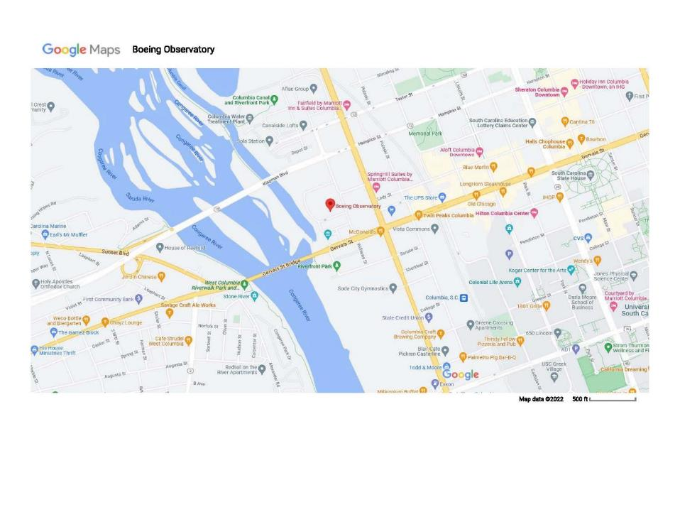

Slide 11
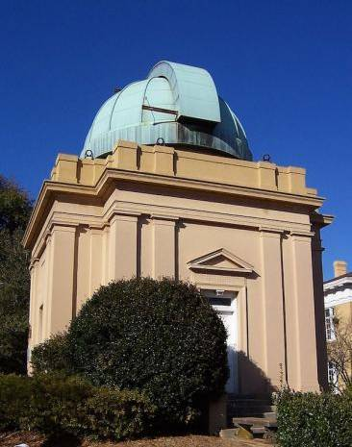
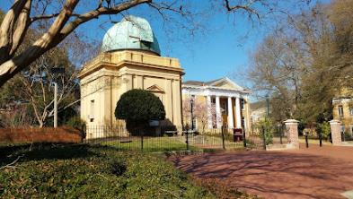
Melton Observatory is located on the campus of the University of South Carolina at 1429 Greene St., Columbia. The observatory opens every Monday night at dusk for two hours, depending on the weather. For exact hours each week, see their website. Admission is free. Insider Tip: This is definitely a trip for older, school-aged children. The telescopes are fragile pieces of equipment, the observation deck is very narrow, the spiral staircase is steep, skinny and goes up for a long time, and the activity, by its nature, has to happen in the dark.

Slide 12
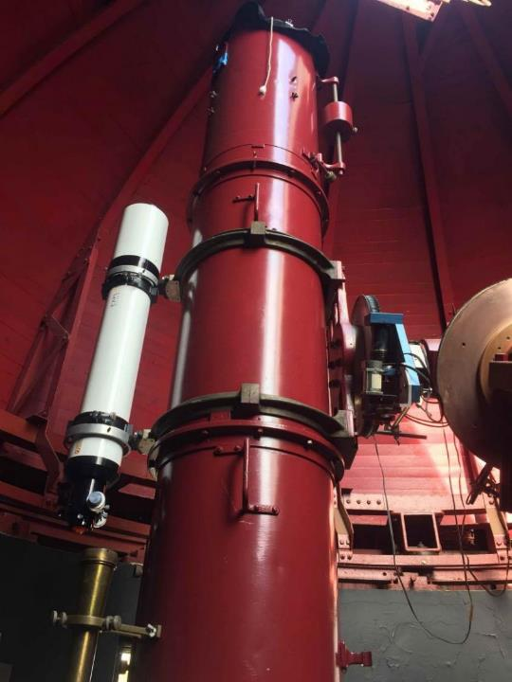
The current mirror is approximately 40 centimeters in diameter, which is between 15 and 16 inches. Current documentation lists the telescope as a 16-inch Cassegrain. The Observatory was designed to house a much larger telescope in the event of one being made available.
Public Observing... The Melton Observatory is open to the public on clear Monday nights (currently 8-10pm) throughout the year, weather permitting. We may also open for special astronomical events. These events will be posted on our home page and our Calendar of Events as well as on our Facebook and Twitter pages as they are available. See our Calendar for a complete list of events, and visit the Sky Report page to see what's currently visible in the night sky. There is no fee for visiting the observatory. Remember to dress for the weather!

Slide 13
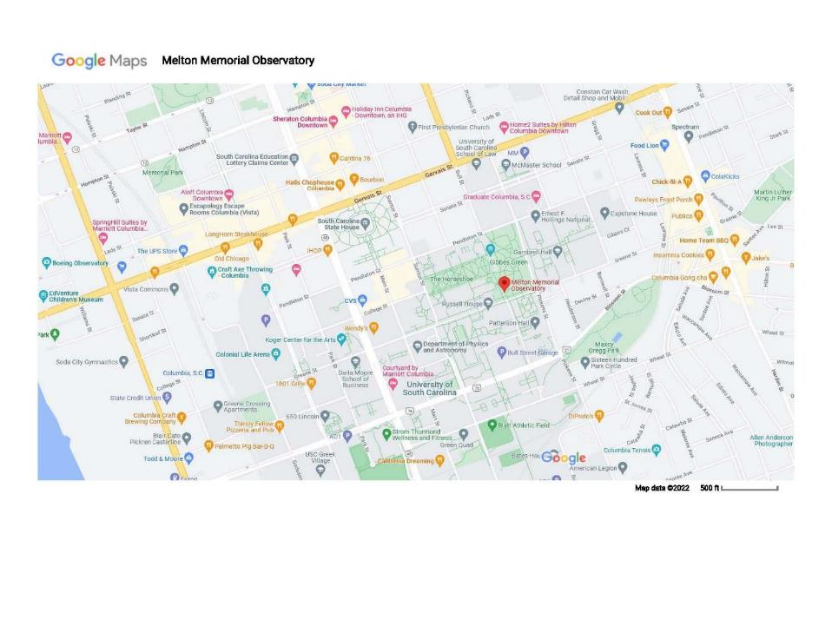

Slide 14
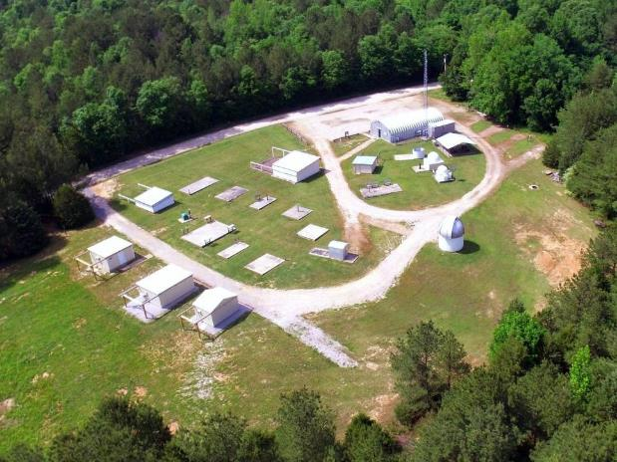
The Gayle H. Riggsbee Observatory (GHRO)
CAAC Telescopes
-8 Inch Alvan Clark Refractor f15
-16 Inch Cassegrain f10
-24 Inch Newtonian Reflector f5
-102mm Lunt H-alpha Solar
Warm up room with microwave ovens and refrigerator
Rest rooms
Shower
Picnic Pavilion
Class room
RV and Tent Camping
Gas Grill
Yard Games
-Corn Hole
-Frisbee
-Badminton
-Volley Ball
Wireless Internet (WiFi)
Address: 1427 29720 Bloomwood Dr, Kershaw, SC 29067 Phone: (704) 996-4215

Slide 15
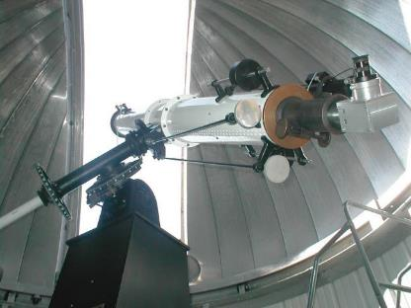
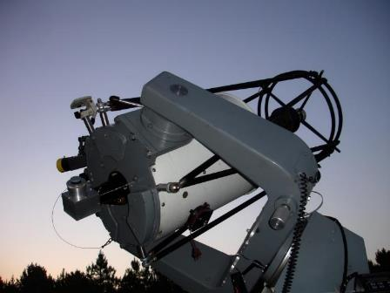
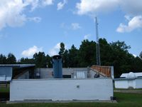
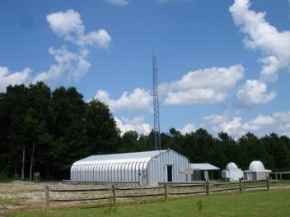
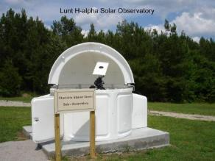
8" Alvan Clark Refractor
16" Cassegrain f10
Ken Steiner Astronomy Outreach Center
102mm Lunt H-alpha Solar Observatory
24" Newtonian Reflector f5

Slide 16
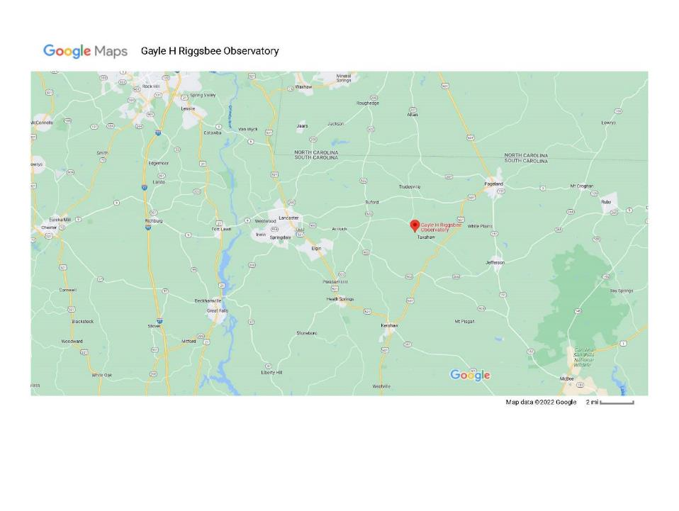

Slide 17
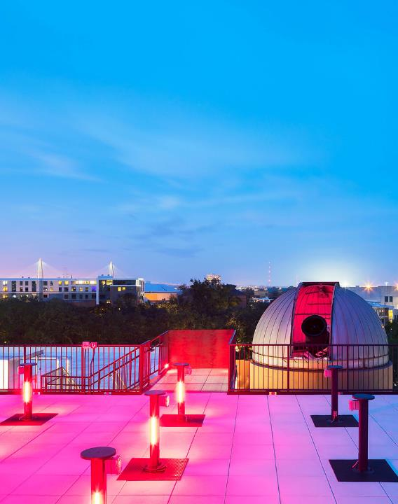
College of Charleston Observatory
Facilities Available During Open House
Our main 24" telescope housed in the dome will not be part of the Open Houses. We will have our smaller, portable telescopes set up on the roof deck, portable planetarium on the first floor, and classrooms with physics and astronomy demos on the third floor. All open house events are free and open to the public.

Slide 18
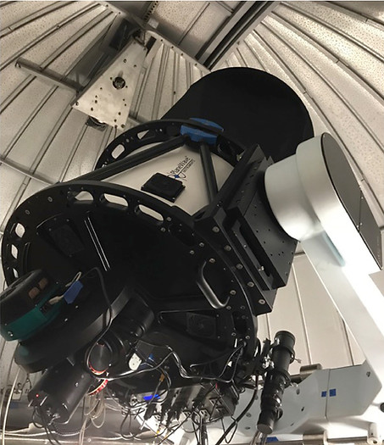
The CofC 24in Telescope​
The CofC Observatory is now home to one of the most powerful telescopes in South Carolina. Our telescope is a PlaneWave Instruments CDK (Corrected Dall-Kirkham) 24in telescope with a Mathis Instruments MI1250 fork on a M1000 mount. It was installed at the College of Charleston observatory on August 25, 2018. The current fork mount can mitigate building vibrations that severely impacted effectiveness of our previous 16inch DFM telescope in the existing location.
CofC faculty and students are able to capture spectacular high-resolution images of galaxies and nebulae, thanks to the telescope’s astrographic design (F ratio = 6.5), which provides excellent imaging with a large format charge-coupled device (CCD) camera, while remaining superb for visual use. It far exceeds the performance of most commercial telescope designs.
Department of Physics and Astronomy
College of Charleston
RITA Hollings Science Center
58 Coming Street
Charleston, SC 29424
​
chartasg@cofc.edu

Slide 19
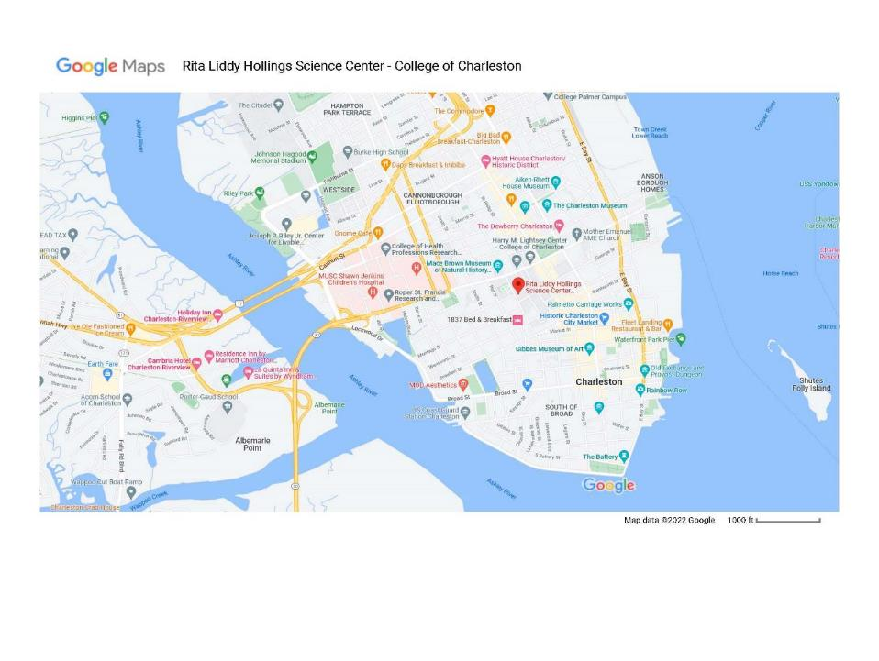

Slide 20
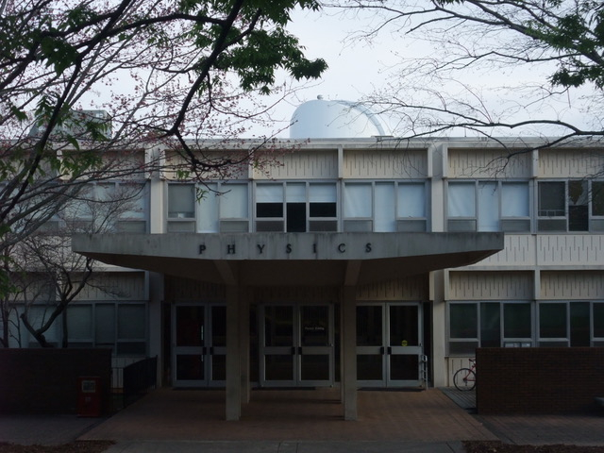
The UGA Observatory is located on top of the Physics Building on the UGA campus.
Department of Physics & Astronomy The University of Georgia Athens, GA 30602-2451 U.S.A.
Tel: (706) 542-2485 Fax: (706) 542-2492 Email: physast@uga.edu
The UGA Observatory

Slide 21
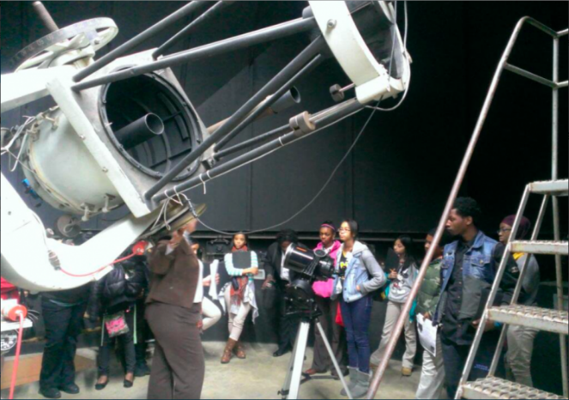
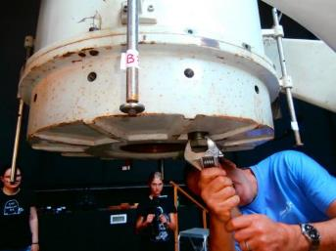
The University of Georgia owns one of the largest visible light telescopes in the state. The main component of the telescope is its 24 inch wide primary mirror, which is mounted in the much larger support and steering structure shown in the photo.
Both the primary and secondary mirrors are being cleaned and recoated in this long-overdue maintenance effort. They should be back from the mirror re-coating company in a few weeks. After their return, and re-installation, the Observatory will return to operations and the autumn public observing schedule will be announced.
https://www.physast.uga.edu/observatory/schedule

Slide 22
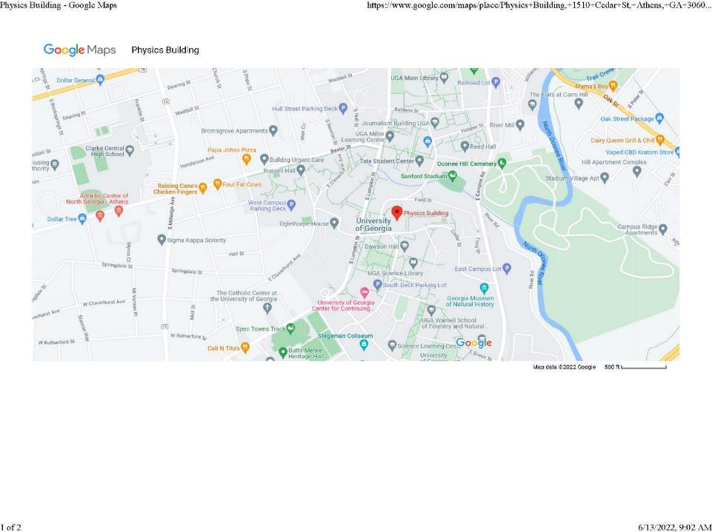

Slide 23
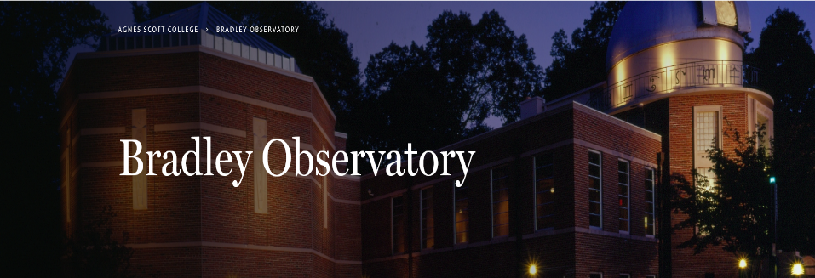
The astronomical teaching and research facility is located on the Agnes Scott College campus in Decatur, Georgia. The observatory, named in honor of William C. and Sarah Hall Bradley, contains the 70-seat Delafield Planetarium and a 100-seat capacity lecture hall.
The building also contains a library/seminar room, two faculty offices, a darkroom, a student computer lab and an observing plaza for astronomical viewing. The large dome atop the observatory houses the 30-inch Lewis H. Beck telescope.
Information Alert
Bradley Observatory at Agnes Scott College is closed due to the COVID-19 pandemic.
For additional information, please contact Channon Weeks at crweeks@agnesscott.edu.

Slide 24
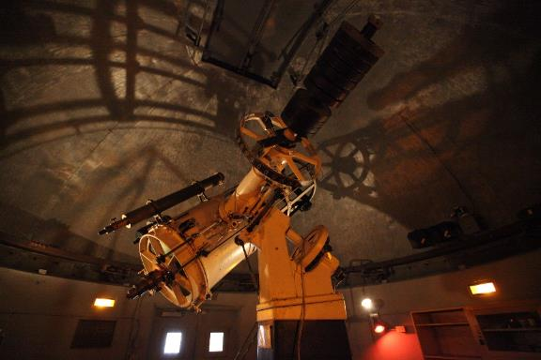
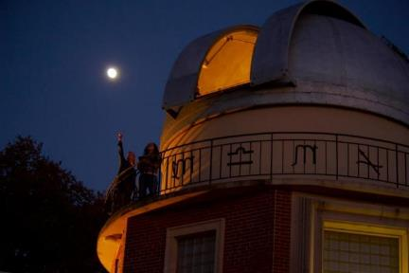
The Beck Telescope
The Beck Telescope is a 30-inch reflector. This 1930 vintage Cassegrain has a Warner & Swasey mounting with optical elements by J.W. Fecker. It was completely refurbished and modified for its installation in 1950 by the Perkin-Elmer Corporation. The telescope tracking control system was modernized and upgraded during the summer of 1998, and the mirrors were refinished during the renovations in 2000.
Optical Telescopes
The observatory contains eight Celestron Nexstar 4SE telescopes for use in Astronomy 120. A variety of Celestron and Meade 8-inch and 10-inch Schmidt-Cassegrain telescopes are used in Astronomy 120L and 200L. Astronomy 200L students also use the Bradley Radio Telescope (BrAT), a steerable 3.1 m diameter radio telescope with an L band (21 cm) receiver.

Slide 25
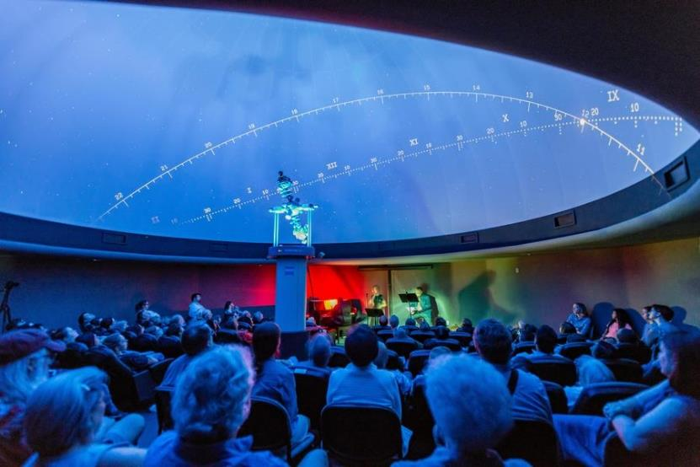
Delafield Planetarium
The Delafield Planetarium located in the Bradley Observatory seats 70 people. The Zeiss machine allows us to project stars, planets, constellation patterns, the sun and the moon onto the ceiling. The planetarium serves Agnes Scott students taking astronomy courses. It's also open to the public for monthly open houses and observatory group tours.

Slide 26
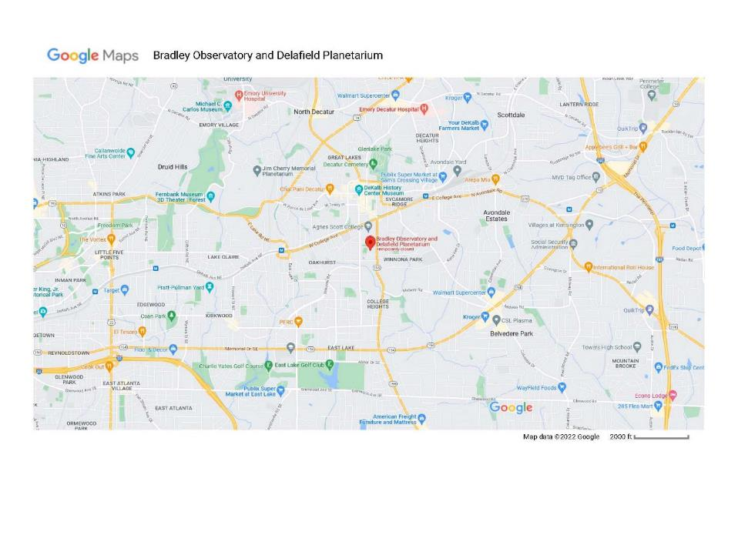

Slide 27
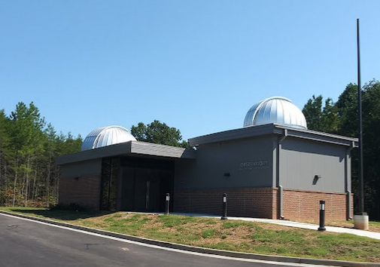
North Georgia Astronomical Observatory
The North Georgia Astronomical Observatory exists to promote astronomy education to University of North Georgia students, as well as the general public. This state-of-the-art facility is located only four miles from the UNG Dahlonega Campus.

Slide 28
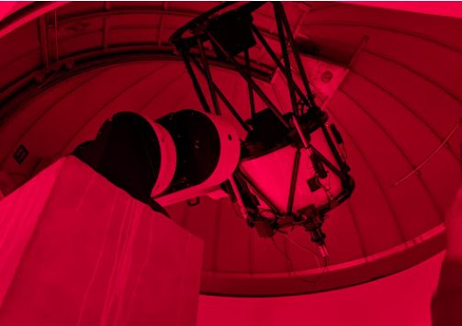
Public Telescope Viewing
Friday - Saturday 8:00 p.m. - 12:00 a.m.
Students and community members are invited to free telescope viewings of the night sky on Friday and Saturday evenings between, weather permitting.
Two key pieces of equipment are the brand-new telescopes measuring at 24 and 28 inches across in the primary mirror diameter.
George E. Coleman, Sr. Planetarium
At the George E. Coleman, Sr. Planetarium, students and the general public can explore the night sky as seen from Earth, or fly into the cosmos to explore other worlds in our dome-shaped theater. Planetarium events open to the public are FREE unless otherwise stated.
You will be truly immersed in the universe and see incredible modern-day scientific discoveries!
The planetarium features: 30-foot diameter dome 46 seats
State-of-the-art Digistar 6 Full-Dome Digital Planetarium Projector

Slide 29
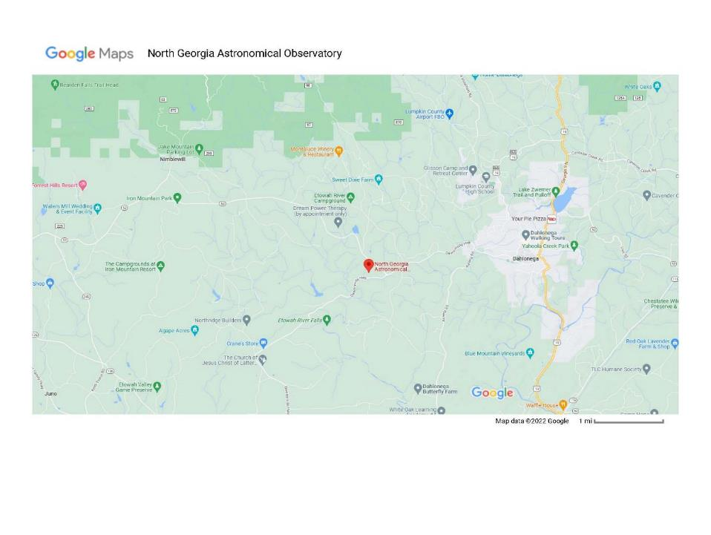

Slide 30
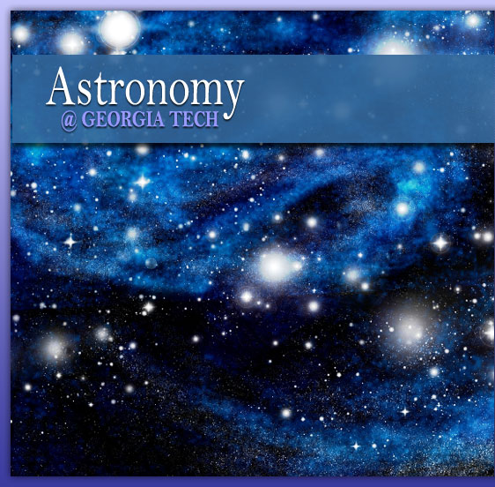
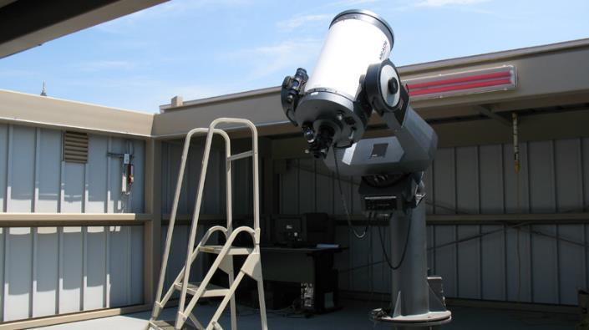
Georgia Tech Contact: Dr. James Sowell Howey W102 / 404.385.1294 jim.sowell@physics.gatech.edu
Public Night Schedule
for 2022-23
coming in July
16” Meade LX200 - A 20” Telescope was added in 2014 but no picture was available

Slide 31
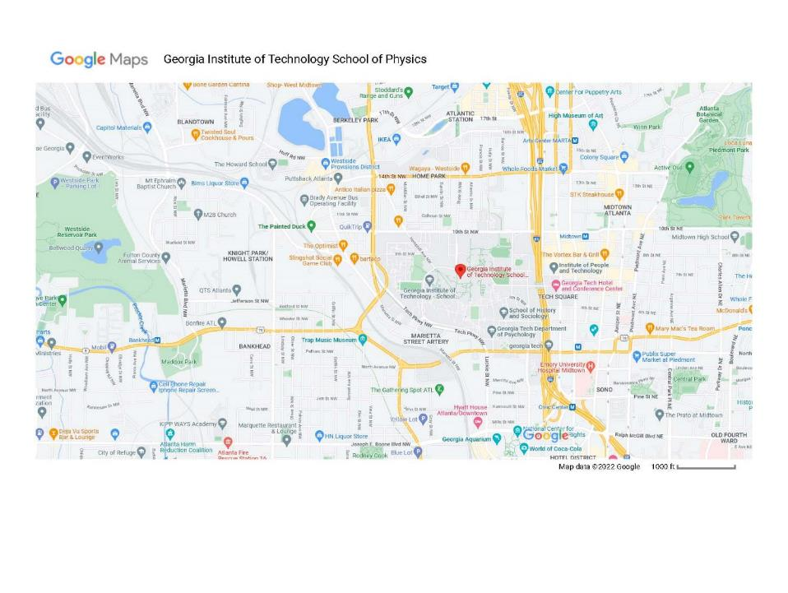

Slide 32
Ralph L. Buice Jr. Observatory at Fernbank Science Center
And
Jim Cherry Memorial Planetarium
CALENDAR FOR PROGRAM SCHEDULES*
Fernbank Science Center 156 Heaton Park Dr. Atlanta, GA 30307
Email FSC Phone: 678-874-7102 Fax: 678-874-7110

Slide 33
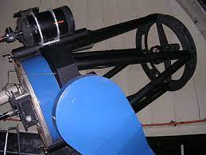
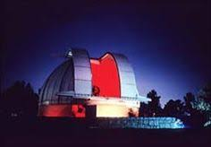
The Dr. Ralph L. Buice, Jr. Observatory at Fernbank Science Center houses a 0.9 meter (36-inch) Cassegrain reflector beneath a 10 meter (30 ft.) dome. This is one of the largest instruments ever dedicated to education and public viewing. FREE public observations are offered every Thursday and Friday evening from 9:00 - 10:00 PM (weather permitting). The observatory will open only when there is a clear view of the night sky. Please call 678-874-7102 between 8:30 PM and 9:00 PM for observatory updates. Please check our calendar for dates that the observatory will be closed.

Slide 34
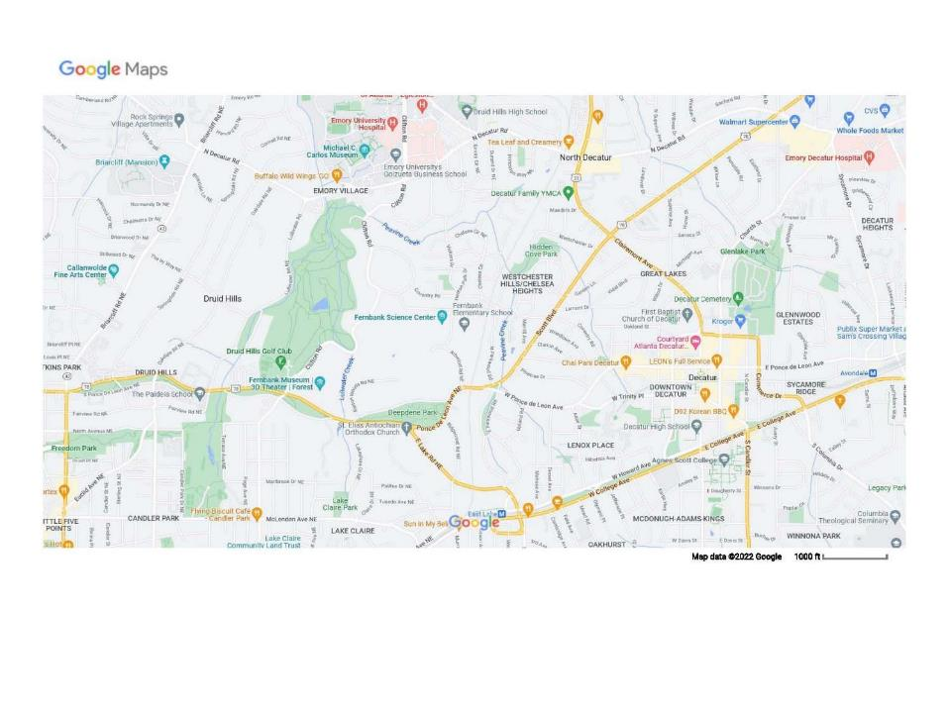

Slide 35
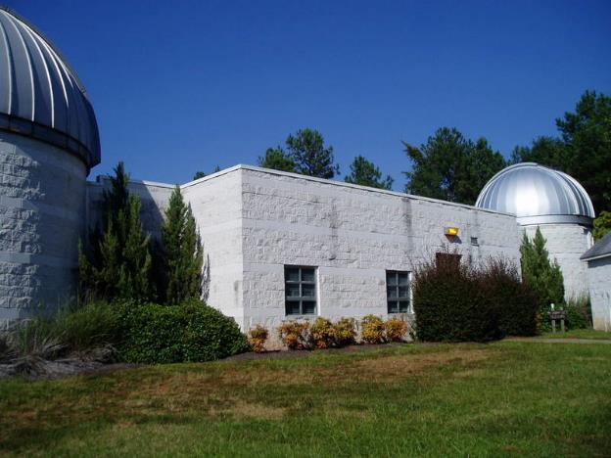
Georgia State University Astronomy
Hard Labor Creek Observatory
Located in the middle of Hard Labor Creek State Park in Rutledge, Georgia (~50 miles east of downtown Atlanta), the observatory is a resource for professional and amateur astronomers. However, an additional service of HLCO has been to the public - bringing the wonders of the Universe to Georgia residents.

Slide 36
Research Facilities:
The Miller Telescope
Plane Wave 24" Corrected Dall-Kirkham Astrograph Telescope
The McAlister Telescope
RC Optics 20" Ritchey-Chrétien Telescope
The Wingert Building
Celestron 11" Schmidt-Cassegrain Telescope
Out of an abundance of caution in light of recent cases of COVID-19 confirmed in the Atlanta Metro Area,
ALL OPEN HOUSES ARE SUSPENDED UNTIL FURTHER NOTICE.

Slide 37
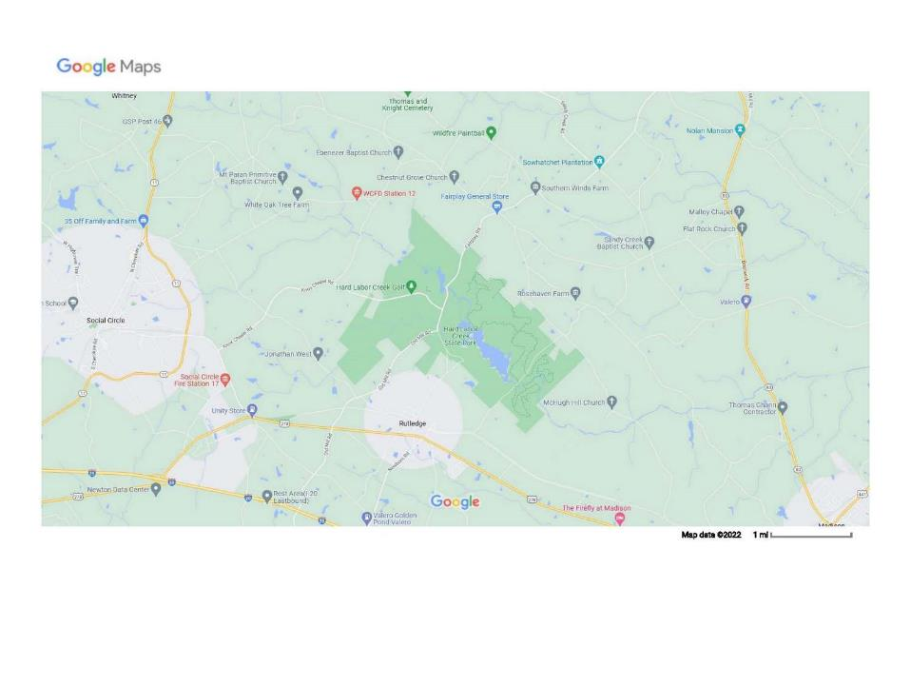

Slide 38
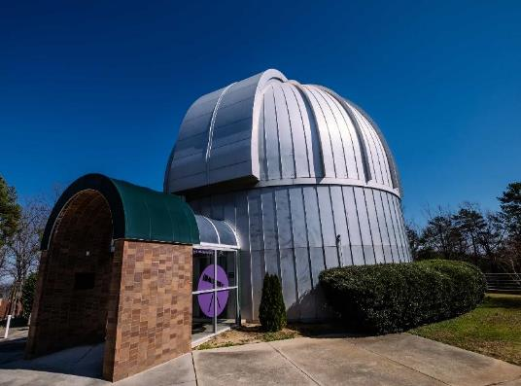
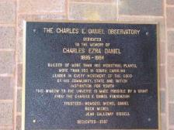
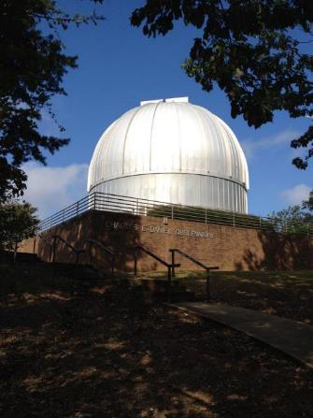
Charles E. Daniel Observatory - Roper Mountain Science Center & Planetarium
https://www.ropermountain.org/
https://rmastro.com/

Slide 39
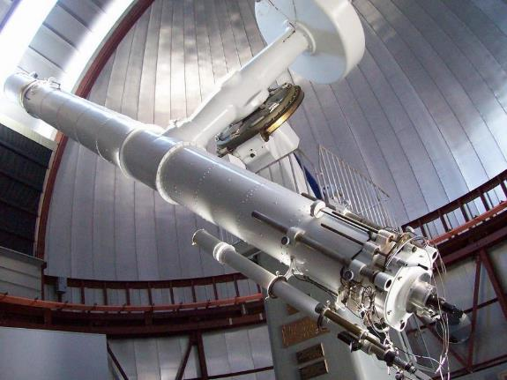
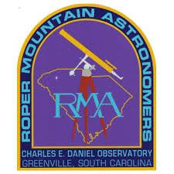
As a Greenville County Schools facility, the Daniel Observatory is open to the public only during special events.
We hold our RMA Club Meetings on the third Thursday of each month at 7:30 pm, except December and August. We meet at the Roper Mountain Science Center in Greenville SC, on the top floor of the Wilkins Conference Center next to the Charles E. Daniel Observatory.
The Charles E. Daniel Observatory features a very historic 23″ refractor telescope, the eighth largest of its kind in the nation. The Great Refractor was completed in 1882 for Princeton University and was the main instrument in their Halsted Observatory. The lens was figured by Alvan Clark and Sons of Cambridge, Massachusetts. In 1933, the telescope was entirely rebuilt by J. W. Fecker Company. The U.S. Naval Observatory owned the telescope from 1964 until 1978, when it was offered to the School District of Greenville County.

Slide 41
https://astroclubaugusta.weebly.com/
Nine Mile Range-Deep Sky Observing - NMR-DSO This site is available only to our members. If you are a member, contact our President for directions.
Monthly Observing sessions (Weather Permitting)
See the Calendar of events for upcoming dates.

