Slide 1
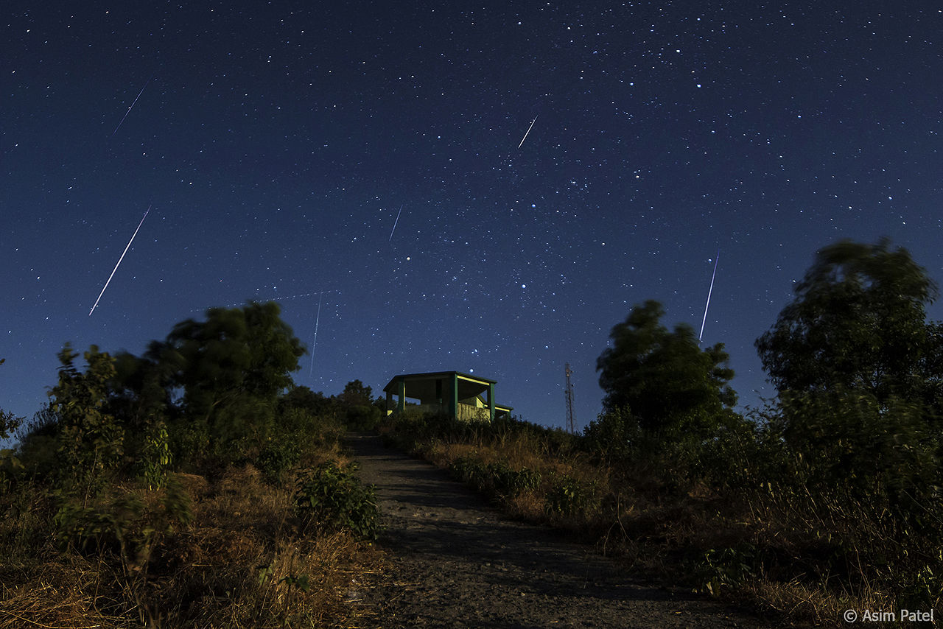
The Geminid Meteors are considered one of the most spectacular showers of the year.

Slide 2
The Geminids are a prolific meteor shower caused by the object 3200 Phaethon, which is thought to be a Palladian asteroid with a "rock comet" orbit. This would make the Geminids, together with the Quadrantids, the only major meteor showers not originating from a comet.

Slide 3
Most meteors in annual showers have comets as their sources. But not December’s Geminid meteors, whose source, known as 3200 Phaethon, is a strange hybrid of an asteroid and a comet. This “rock-comet” isn’t icy, like a comet is. But it’s known to brighten as it nears the sun, as comets do. And it has a tail. It is still not known how material from the asteroid’s surface, or interior, is released into the meteoroid stream.

Slide 4
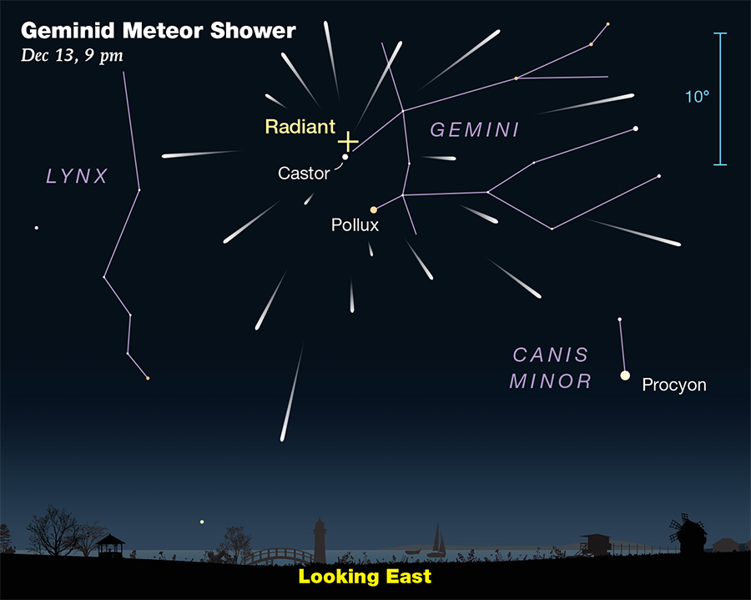

Slide 5
The meteors from this shower are slow moving, and usually peaks around December 4–16, with the date of highest intensity being the morning of December 14. Recent showers have seen 120–160 meteors per hour under optimal conditions, generally around 02:00 to 03:00 local time.

Slide 6
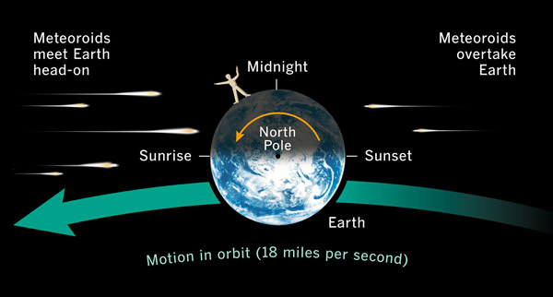

Slide 7
This asteroid-origin shower will start peaking around 8:30 PM on December 14 and carry on all the way to 6:30 AM the next morning.
Further, since the Moon will be at a very dim phase during this time, it should make for a splendid sky-watching experience

Slide 8
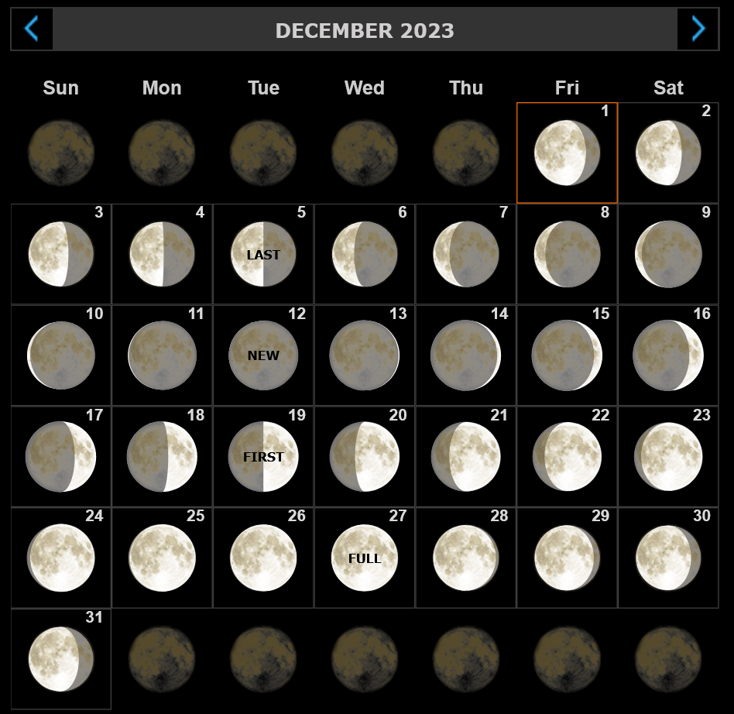

Slide 9
Noteworthy Minor Meteor Shower Peaks:
December 2: Pheonicid Meteor Shower
December 6: Phi Cassiopeid Meteor Shower
December 7: Puppid-Velid Meteor Shower
December 9: Monocerotid Meteor Shower
December 12: Sigma Hydrid Meteor Shower
December 16: Comae Berenicid Meteor Shower
December 20: Leonis Minorid Meteor Shower

Slide 10
December Highlights
December 4: Mercury at Greatest Elongation East
December 12: New Moon
December 14-15: Geminid Meteors
December 22: December Solstice
Announcing the proper start of winter, the December Solstice will take place on this day, marking the shortest day the Northern Hemisphere will experience all year.
December 22-23: Ursid Meteor Shower
The Ursids Meteor Shower still produces an impressive 10 meteors per hour at peak.
To spot the Ursids, search for the Ursa Minor constellation, from 5:30 PM IST on December 22. The shower will continue peaking till 6:30 AM the next morning.
December 27: Full Moon/Cold Moon
This month's Full Moon is termed the Cold Moon due to the chilly temperatures and dark nights prevalent during this time of the year.

