Slide 1
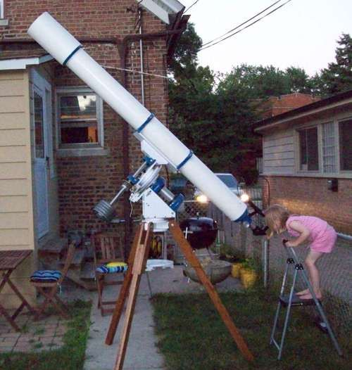
Astronomical Telescope Eyepieces
Everything (or at least some) you wanted to know but were afraid to ask.
Notes:
Eyepieces are the most important accessory for a telescope. Why?
Inexpensive telescopes are supplied with low quality eyepieces. Upgrading to better quality eyepieces is the easiest way to improve performance.
Expensive telescopes are only supplied with one eyepiece - not enough to cover all the basics. The manufacturer leaves it to you to choose more eyepieces based on your observing preferences and budget.

Slide 2
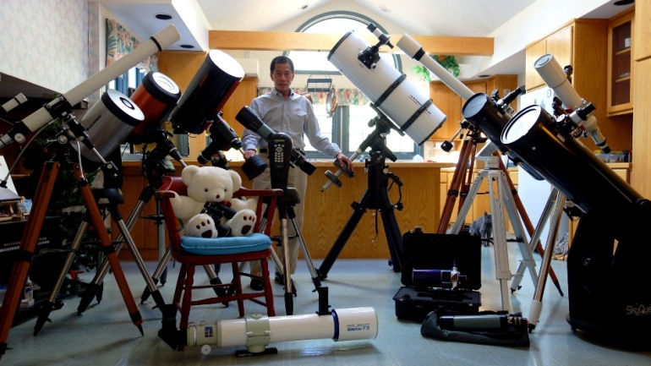
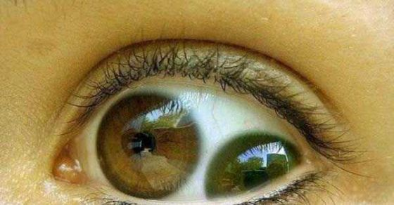
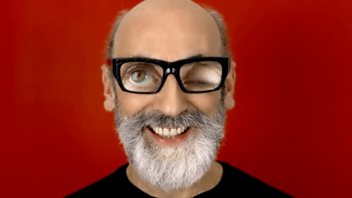
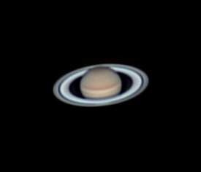
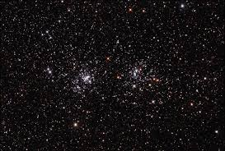
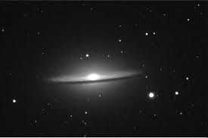
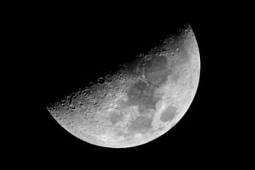
Considerations
Your Telescope
Your Eyes
Your Use
Your Wallet
Notes:
Telescope: Reflector – SCT or Newtonian - Refractor – F4 or F10 etc.
Eyes: Age affects exit pupil – Glasses?
Use: High power for planets – Low power for nebula – aren’t sure
Wallet: $$$ to spend Range from $10 - $1000

Slide 3
Important Terms
Focal length
The focal length of an eyepiece is the distance from the principal plane of the eyepiece where parallel rays of light converge to a single point. When in use, the focal length of an eyepiece, combined with the focal length of the telescope objective, determines the magnification. It is usually expressed in millimeters when referring to the eyepiece alone.
Field of View
The field of view, often abbreviated FOV, describes the area of a target that can be seen when looking through an eyepiece. The field of view seen through an eyepiece varies, depending on the magnification achieved when connected to a particular telescope, and also on properties of the eyepiece itself.
Actual field of view
The angular size of the amount of sky that can be seen through an eyepiece when used with a particular telescope, producing a specific magnification. It ranges typically between 0.1 and 2 degrees.
Apparent field of view
this is a measure of the angular size of the image viewed through the eyepiece, in other words, how large the image appears (as distinct from the magnification). The measurement ranges from 30 to 110 degrees.
Notes:
FOCAL LENGTH – Determines the magnification
FIELD OF VIEW - describes the area of a target that can be seen
Actual field of view - The angular size of the amount of sky that can be seen
Apparent field of view - this is a measure of the angular size of the image

Slide 4
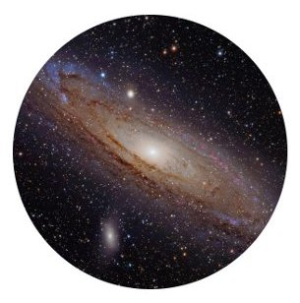
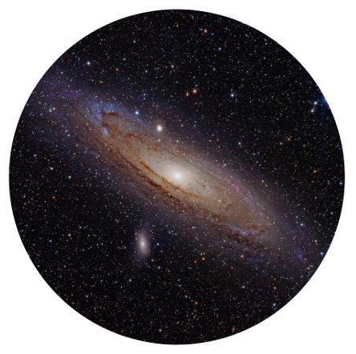
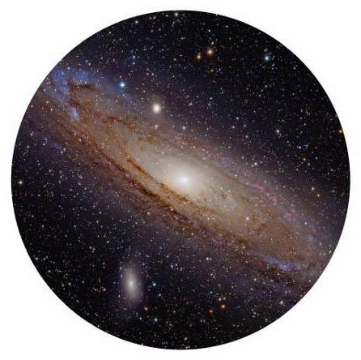
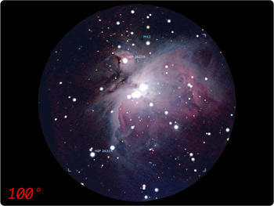
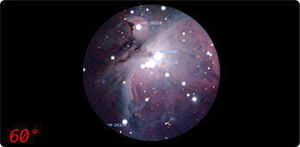
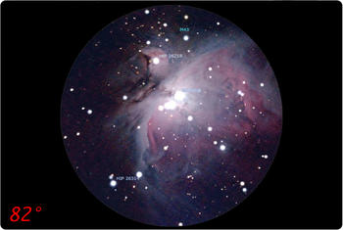
Simulation of views through various telescope eyepieces
Left image shows image through an eyepiece with a narrow apparent field of view.
Center image shows image through an eyepiece of the same focal length but wider apparent field of view, and how the image is larger and shows a greater area.
Right image shows image with the same apparent field of view as the center image, but shorter focal length giving greater magnification. The result is the same true field of view as the first image but at greater magnification.
Notes:
Left image shows image through an eyepiece with a narrow apparent field of view.
Center image shows image through an eyepiece of the same focal length but wider apparent field of view, and how the image is larger and shows a greater area.
Right image shows image with the same apparent field of view as the center image, but shorter focal length giving greater magnification. The result is the same true field of view as the first image but at greater magnification.

Slide 5
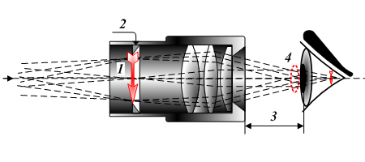
The Eye Relief
1 Real image 2 - Field diaphragm 3 - Eye relief 4 - Exit pupil
The eye needs to be held at a certain distance behind the eye lens of an eyepiece to see images properly through it. This distance is called the eye relief.
Notes:
A larger eye relief means that the optimum position is farther from the eyepiece, making it easier to view an image. However, if the eye relief is too large it can be uncomfortable to hold the eye in the correct position for an extended period of time, for which reason some eyepieces with long eye relief have cups behind the eye lens to aid the observer in maintaining the correct observing position. The eye pupil should coincide with the exit pupil.
Eye relief typically ranges from about 2 mm to 20 mm. Long focal-length eyepieces usually have ample eye relief, but short focal-length eyepieces are more problematic. Until recently, and still quite commonly, eyepieces of a short-focal length have had a short eye relief. Good design guidelines suggest a minimum of 5–6 mm to accommodate the eyelashes of the observer to avoid discomfort. Modern designs can correct for this, and viewing at high power becomes more comfortable. This is especially the case for glasses wearers, who may need up to 20 mm of eye relief to accommodate their glasses.

Slide 6
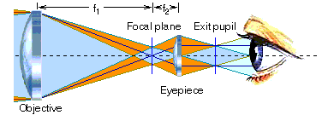
Two Common Issues
The kidney bean effect occurs when the exit pupil is very large and close to the size of eye pupil
This appears to the observer as a giant kidney bean shaped dark region that meanders around the field as head moves.
In some long f.l or wide angle eyepieces, it is sometimes necessary to move the eye closer to the eyepiece in order to see the edge of the field.
The "blackout" effect mainly arises with eyepieces of large eye relief and exit pupil or barlowing a low focal eyepiece such as a 35 mm. Blackouts aren't a characteristic of the eyepiece, they're simply the observer holding his eye too close to the eyepiece.

Slide 7
How Exit Pupil Relates to Power The powers at which a telescope will work well depend on its aperture.
The exit pupil must be smaller than the pupil of your eye, or else some of the light rays will not make it into the pupil (light will be wasted).
Exit pupil size is calculated in millimeters using these formulas
Exit pupil size (mm) | = | Telescope aperture in mm __________________________ Telescope magnification
Exit pupil size (mm) | = | Eyepiece focal length in mm __________________________ Telescope f-ratio
203mm (8” Reflector)
2.54mm = _______________________
100X
32mm
3.20mm = _______________________
f/10
127mm (5” Refractor)
1.27mm = _______________________
100X
32mm
4.57mm = _______________________
f/7
Notes:
The powers at which a telescope will work well depend on its aperture. A larger telescope gathers more light and captures a broader wavefront, giving sharper images. One handy way to classify powers is in terms of "power per inch" of aperture. For example, 80x on an 8"-aperture telescope is 10 power per inch. Another way is to go by the size of the exit pupil (the bundle of light rays coming out of the eyepiece). Exit pupil size in inches is the reciprocal of power per inch. More commonly, exit pupil size is calculated in millimeters using these formulas:
The exit pupil must be smaller than the pupil of your eye, or else some of the light rays will not make it into the pupil (light will be wasted). A young person’s fully dark-adapted eyes may have 7mm-wide pupils. As you age, maximum pupil diameter decreases. For middle-aged adults, the practical maximum is more like 5mm.
At the other end of the scale, at magnifications that yield an exit pupil in the range of 0.5mm to 1.0mm, empty magnification begins to set in, depending on the quality of your telescope and your eyes. In other words, this much magnification really starts to degrade the image you see.
Wearing eyeglasses: When observing, you can usually leave your glasses off if you are farsighted (can’t focus on nearby objects) or nearsighted (can’t focus on distant objects). Most telescope focusers can compensate for these problems. With astigmatism, you can leave your glasses off at high powers (unless your astigmatism is severe), since astigmatism shows up primarily at the periphery of your cornea, and most high power observing involves examining small objects in the center of the field. At low powers, leave your glasses on if you have astigmatism.

Slide 8
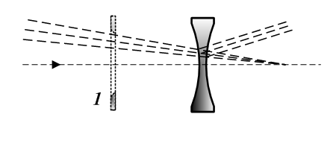
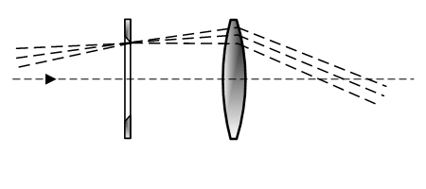
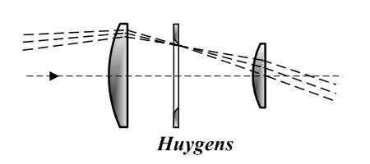
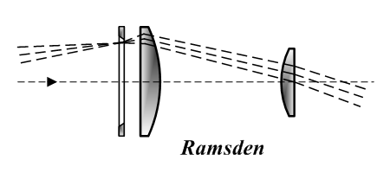
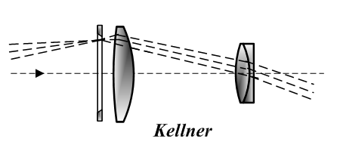
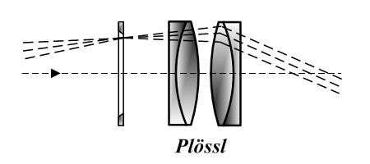
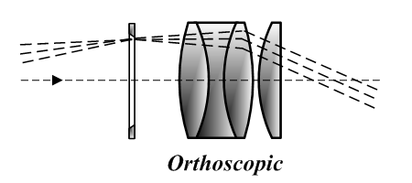
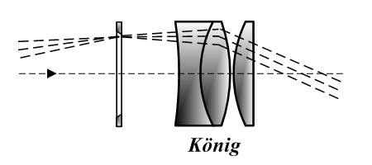
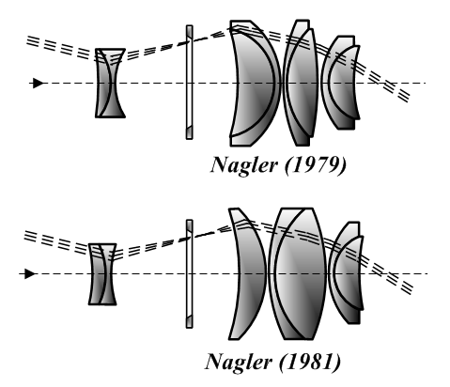
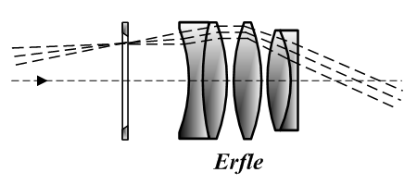
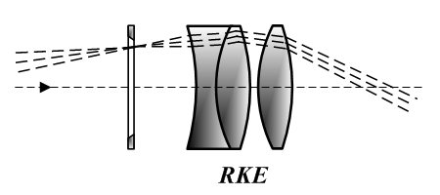
Optical Designs
Galilean
Kepler
Notes:
Galilean: A “Negative” lens. Netherlands in 1608. Used in Galileo Galilei's 1609 telescope design which gave this type of eyepiece arrangement the name "Galilean". This type of eyepiece is still used in very cheap telescopes, binoculars and in opera glasses.
Kepler: A “Convex” lens. This configuration may have been used in the first refracting telescopes from the Netherlands and was proposed as a way to have a much wider field of view and higher magnification in telescopes in Johannes Kepler's 1611 book Dioptrice.
Huygens: Invented by Christiaan Huygens in the late 1660s and was the first compound (multi-lens) eyepiece. These eyepieces work well with the very long focal length telescopes. This design is now considered obsolete since with today's shorter focal length telescopes the eyepiece suffers from short eye relief, high image distortion, chromatic aberration, and a very narrow apparent field of view. Since these eyepieces are cheap to make they can often be found on inexpensive telescopes and microscopes. Because Huygens eyepieces do not contain cement to hold the lens elements, telescope users sometimes use these eyepieces in the role of "solar projection", i.e. projecting an image of the Sun onto a screen. Other cemented eyepieces can be damaged by the intense, concentrated light of the Sun.
Ramsden: Jesse Ramsden in 1782. The design is slightly better than Huygens but still not up to today’s standards.
Kellner or “Achromat”: Carl Kellner designed this first modern achromatic eyepiece in 1849, also called an "achromatized Ramsden“. They are inexpensive and have fairly good image from low to medium power and are far superior to Huygenian or Ramsden design. The eye relief is better than the Huygenian and worse than the Ramsden eyepieces. The biggest problem of Kellner eyepieces was internal reflections. Today's anti-reflection coatings make these usable, economical choices for small to medium aperture telescopes with focal ratio f/6 or longer. The typical apparent field of view is 40–50°.
Plössl or "Symmetrical“: Designed by Georg Simon Plössl in 1860. The compound Plössl lens provides a large 50° or more apparent field of view, along with relatively large FOV. This makes this eyepiece ideal for a variety of observational purposes including deep-sky and planetary viewing. The chief disadvantage of the Plössl optical design is short eye relief compared to an orthoscopic. The short eye relief is more critical in short focal lengths below about 10 mm, when viewing can become uncomfortable especially for people wearing glasses.
The Plössl eyepiece was an obscure design until the 1980s when astronomical equipment manufacturers started selling redesigned versions of it. Today it is a very popular design on the amateur astronomical market.
This eyepiece is one of the more expensive to manufacture because of the quality of glass, and the need for well matched convex and concave lenses to prevent internal reflections. There are notable differences between cheap Plössls with simplest anti-reflection coatings and well made ones.
Orthoscopic or "Abbe“: It was invented by Ernst Abbe in 1880. Until the advent of multicoatings and the popularity of the Plössl, orthoscopics were the most popular design for telescope eyepieces. Even today these eyepieces are considered good eyepieces for planetary and lunar viewing.
König: designed in 1915 by German optician Albert König. The design allows for high magnification with remarkably high eye relief — the highest eye relief proportional to focal length of any design before the Nagler
Erfle: They were invented for military purposes by Heinrich Erfle in 1921. Erfle eyepieces are designed to have wide field of view (about 60 degrees), but they are unusable at high powers because they suffer from astigmatism and ghost images. However, with lens coatings at low powers (focal lengths of 20 mm and up) they are acceptable, and at 40 mm they can be excellent. Erfles are very popular because they have large eye lenses, good eye relief and can be very comfortable to use.
RKE: It was designed by David Rank for the Edmund Scientific Corporation, who marketed it throughout the late 1960s and early 1970s. RKE stands for "Rank Kellner Eyepiece'”. This design provides slightly wider field of view than classic Kellner design and makes its design similar to a widely spaced version of the König.
Nagler: Invented by Albert Nagler and patented in 1979, the Nagler eyepiece is a design optimized for astronomical telescopes to give an ultra-wide field of view (82°). Introduced in 2007, the Ethos is an enhanced ultra-wide field design developed at Tele Vue Optics and claims a 100–110° AFOV. This is achieved using exotic high-index glass and up to eight optical elements in four or five groups; there are five similar designs called the Nagler, Nagler type 2, Nagler type 4, Nagler type 5, and Nagler type 6. The newer Delos design is a modified Ethos design with a FOV of 'only' 72 degrees but with a long 20mm eye relief.
The main disadvantage to Naglers is in their weight. Long focal length versions exceed 0.5 kg (1.1 lb), which is enough to unbalance small telescopes. Another disadvantage is a high purchase cost, with large Naglers' prices comparable to the cost of a small telescope.

Slide 9
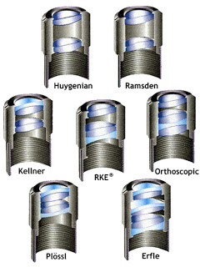
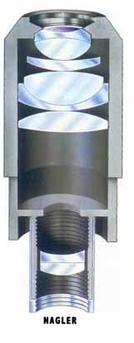
Notes:
Just a more realistic view of the lenses involved

Slide 10
Practical Focal Lengths for Eyepieces
Power Range | Eyepiece (f/4 Telescope) | Eyepiece (f/8 Telescope) | Eyepiece (f/10 Telescope) | Eyepiece (f/15 Telescope)
VERY LOW | 16 - 28mm | 32 - 56mm | 40 - 70mm* | 60 - 105mm*
LOW | 8 - 16mm | 16 - 32mm | 20 - 40mm | 30 - 60mm
MEDIUM | 4 - 8 mm | 8 - 16mm | 10 - 20mm | 15 - 30mm
HIGH | 2.8 - 4mm* | 6 - 8mm | 7 - 10mm | 10 - 15mm
VERY HIGH | 2.0 - 2.8mm* | 4 - 6mm | 5 - 7mm | 7 - 10mm
*Eyepieces in these ranges are not normally practical with a 1.25” barrel.
Notes:
Commonly available eyepieces have focal lengths between 6mm and 40mm. The eyepiece barrel diameter limits how long a focal length can be practically employed. A 32mm Plössl or a 40mm Kellner uses the entire diameter of a standard 1.25" eyepiece barrel; a longer focal length will not cover a wider field. On the other hand, in most eyepiece designs, very short focal lengths (less than 6mm) suffer from impracticably small lenses, which require you to position your eye impossibly close. Some newer eyepiece lines, such as Orion’s Lanthanum series, do provide eyepieces as short as 2.3mm with long eye relief.
If you need focal lengths longer than 40mm, use of a 2" eyepiece barrel for eyepieces up to 60mm focal length or so. That’s enough to get you into the very-low-power range even with an f/15 refractor.

Slide 11
Barrel Sizes
Notes:
There are six standard barrel diameters for telescopes.
0.965 in. (24.5 mm) – This is the smallest standard barrel diameter and is usually found in toy store and shopping mall retail telescopes. Many of these eyepieces that come with such telescopes are plastic, and some even have plastic lenses. High-end telescope eyepieces with this barrel size are no longer manufactured, but you can still purchase Kellner types.
1.25 in. (31.75 mm) – This is the most popular telescope eyepiece barrel diameter. The practical upper limit on focal lengths for eyepieces with 1.25" barrels is about 32 mm. With longer focal lengths, the edges of the barrel itself intrude into the view limiting its size. With focal lengths longer than 32 mm, the available field of view falls below 50°, which most amateurs consider to be the minimum acceptable width. These barrel sizes are threaded to take 30 mm filters.
2 in. (50.8 mm) – The larger barrel size in 2" eyepieces helps alleviate the limit on focal lengths. The upper limit of focal length with 2" eyepieces is about 55 mm. The trade-off is that these eyepieces are usually more expensive, will not fit in some telescopes, and may be heavy enough to tip the telescope. These barrel sizes are threaded to take 48 mm filters (or rarely 49 mm).
2.7 in. (68.58 mm) – 2.7" eyepieces are made by a few manufacturers. They allow for slightly larger fields of view. Many high-end focusers now accept these eyepieces.
3 in. (76.2 mm) – The even larger barrel size in 3" eyepieces allows for extreme focal lengths and over 120° field of view eyepieces. The disadvantages are that these eyepieces are somewhat rare, extremely expensive, up to 5 lbs in weight, and that only a few telescopes have focusers large enough to accept them. Their huge weight causes balancing issues in Schmidt-Cassegrains under 10 inches, refractors under 5 inches, and reflectors under 16 inches. Also, due to their large field stops, without larger secondary mirrors most reflectors and Schmidt-Cassegrains will have severe vignetting with these eyepieces. Makers of these eyepieces include Explore Scientific and Siebert Optics. Telescopes that can accept these eyepieces are made by Explore Scientific and Orion Telescopes and Binoculars.
4 in. (102 mm) – These eyepieces are rare and only commonly used in observatories. They are made by very few manufacturers, and demand for them is low.

Slide 12
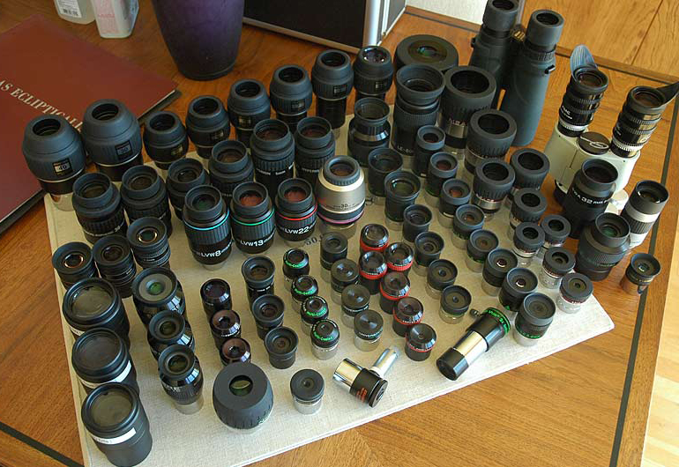
How Many Do I Need?
Notes:
A few. You can observe for a long time with one low-power and one high-power eyepiece, although eventually you will want a few more focal lengths for more magnification options.
Avoid the temptation to go all the way to the limits (very low and very high) until after you’ve filled in the middle range.
For example, for an f/10 telescope, a 25mm and a 9mm eyepiece make a good starter set; you can add something around 15mm and perhaps 6mm next.
With a several different eyepieces, you have a better chance of hitting the optimal power for the particular object you are observing, given the sky conditions at the time. Usually, you’ll want to start out with low power (i.e., long eyepiece focal length, such as 25mm or 30mm) to get the object in the field of view of the telescope. Then you might try a slightly higher-power (shorter focal length, maybe 18mm or 15mm) eyepiece and see if the image looks any better. If it does, swap in an even higher-power eyepiece, etc., until you hit that "sweet spot" where image brightness, image scale, and the amount of visible detail combine to form the most pleasing view.

Slide 13
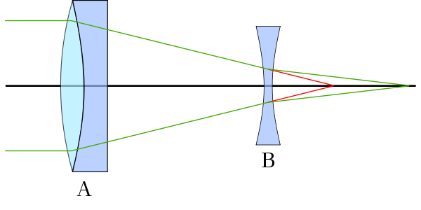
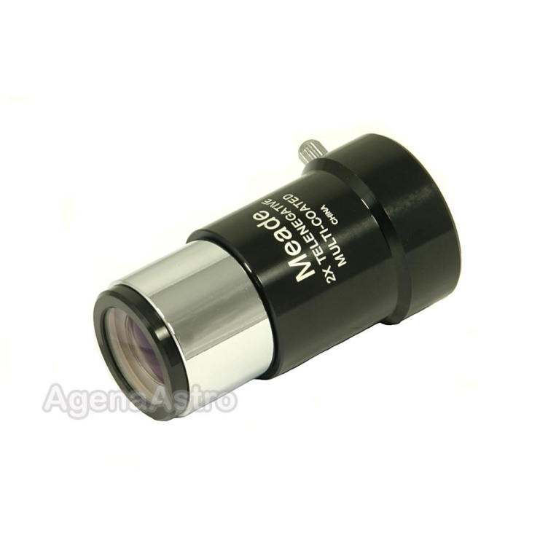
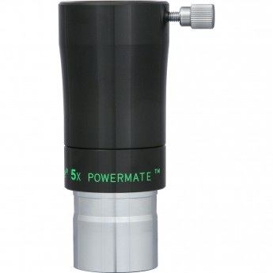
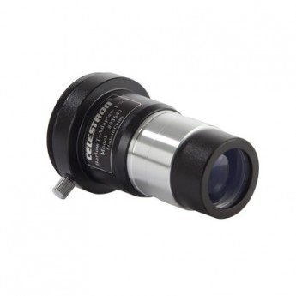
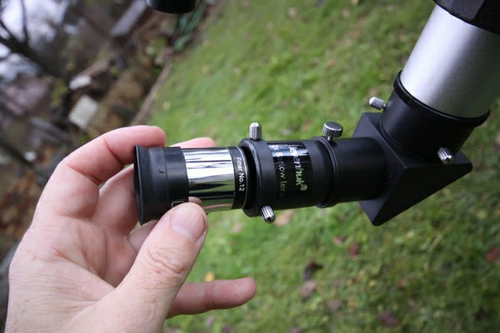
Barlow Lens
(A) without (red) and with (green) a Barlow lens optical element (B)
By using a barlow lens you can get away with having fewer eyepieces in your collection
Notes:
A Barlow lens may be placed immediately before an eyepiece to effectively increasing the magnification of the image.
Most commonly, Barlow lenses are 2x or 3x, but adjustable Barlows are also available.
A common misconception is that higher magnification equates to a higher-quality image. However, in practice, the quality of the image generally depends on the quality of the optics (lenses) and viewing conditions, not on magnification.
To gain the maximum benefit from the barlow, choose eyepiece focal lengths that are not multiples of each other. In other words, if you have eyepieces of 25mm, 12.5mm, and 6mm — multiples of 2 — then a 2x barlow won’t provide much in the way of additional magnifications. But if your eyepieces are 25mm, 15mm, and 10mm, then use of the 2x barlow with each, respectively, will provide 12.5mm, 7.5mm, and 5mm effective focal lengths — just like having three additional (and different!) eyepieces.

Slide 14
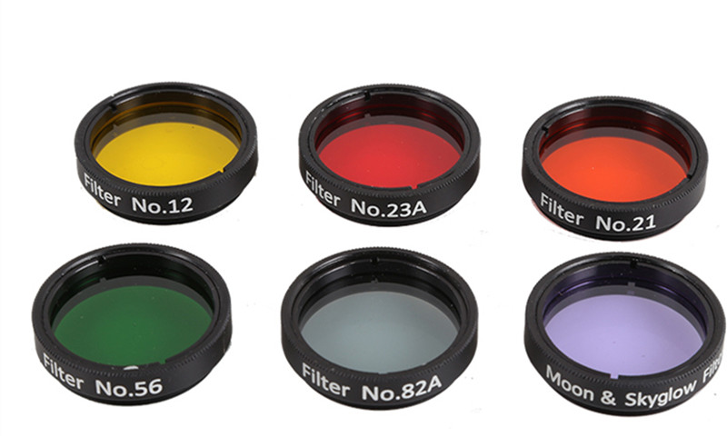
Filters
Notes:
Some of the more popular colors

Slide 15
Not Useful | Good | Excellent | Probably the Best
Wratten Number and Color | Moon | Mercury | Venus | Mars | Jupiter | Saturn
#8 Light Yellow | With small telescopes |  |  | Maria, Dust clouds | Belts
#11 Yellow-Green |  |  |  | Maria | Belts | Cassini Division
#12 Yellow |  |  | Improves contrast | Maria, Atmospheric clouds | Belts, Poles
#15 Dark Yellow / Amber | Useful | Daylight | Low contrast clouds | Maria, Dust clouds, Polar regions | Belts, Poles, Festoons
#21 Orange | Very useful | Daylight surface |  | Surface edge detail | Belts, Red spot, Festoons | Bands, poles
#23A Light Red |  | Daylight, Twilight |  | Maria and surface, Dust clouds, Polar caps | Blue clouds | Blue clouds
#25 Red |  | Daylight, Twilight | Upper clouds | Maria, Polar caps | Improves contrast
#29 Dark Red |  |  | Terminator | Maria, Polar caps | Moon transits | Clouds
#38A Dark Blue |  |  | Upper clouds | Dust storms, Polar caps, Violet clearing | Belts, Red spot | Bands, rings
#47 Violet | Useful |  | Upper clouds | Clouds and haze above poles |  | Ring detail
#56 Light Green | Useful |  | Improves contrast | Dust storms, Polar caps | Red Spot | Bands, Poles
#58 Green | Useful |  | Improves contrast | Dust storms, Polar caps | Belts | White bands, Poles
#80A Blue | Very useful | Twilight surface | Upper clouds | High clouds, Ice caps | Rills, Festoons, Red Spot | Bands, Poles
#82A Light Blue | Useful | Twilight surface | Upper clouds | Polar caps, Surface | Belt transition | Band transition
Notes:
A handy chart for what filters work best for what objects

Slide 16
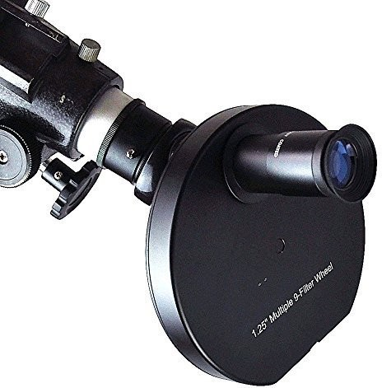
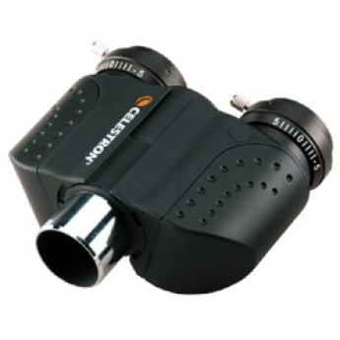
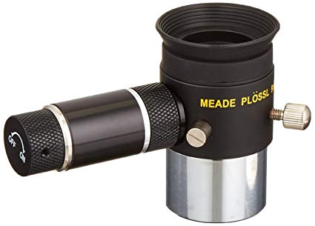
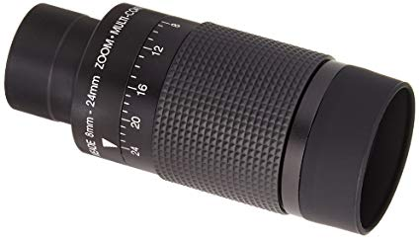
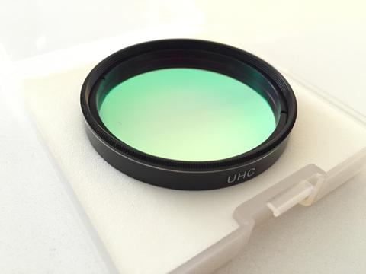
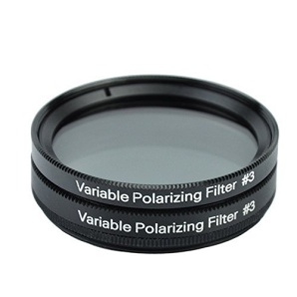
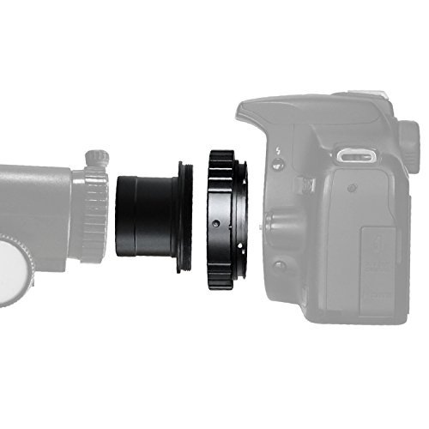
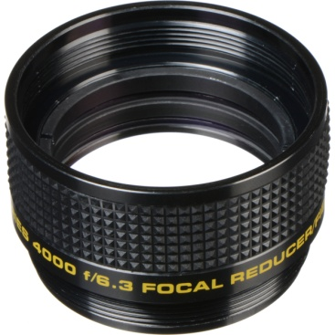
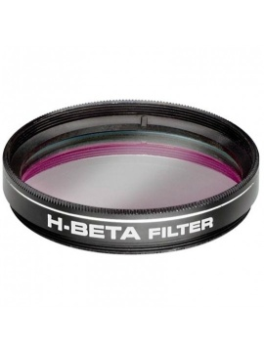
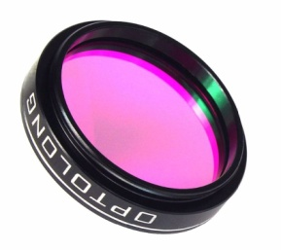
Accessories
Notes:
Filter Wheel
Illuminated Eyepiece: Reticle crosshair or polar finder pattern
Zoom Eyepiece: Usually in 1.25” barrel and 8mm – 24mm range
Bioviewer: Gives depth of field perspective. But, needs pair of matching eyepieces and is heavy and expensive
Prime Focus adapter: Camera replaces eyepiece. Can also do Eyepiece projection photography with different adapters or eyepieces with camera threads on the end (Celestron Ultima Duo)
Focal Reducer/Field Flatner: Primarily for photography. Shortens exposure time and corrects for normal “edge of field” distortions. Available for both short FL refractors and SCTs
Specialty Filters: Skyglow, Nebula, Oxygen III, Polarizing, Hydrogen Beta, Ultra Block, Narrow Band, Ultra High Contrast (UHC), Ultra Block, Broadband………….

Slide 17
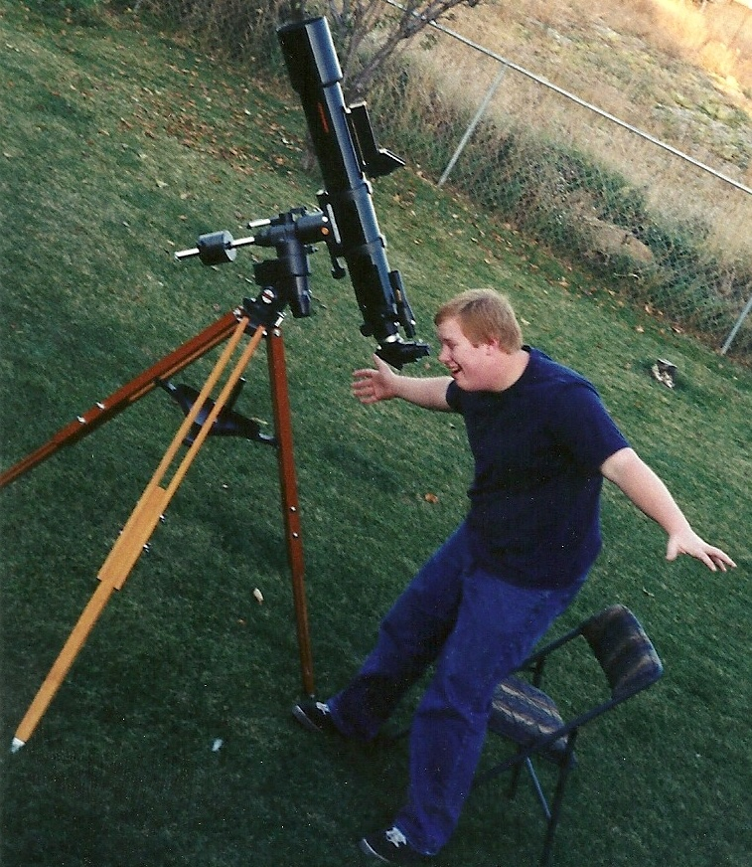
References
https://en.wikipedia.org/wiki/Eyepiece
https://en.wikipedia.org/wiki/Barlow_lens
https://www.astronomics.com/how-to-pick-an-eyepiece_t.aspx
https://www.opticsplanet.com/howto/how-to-guide-telescope-eyepieces.html
Choosing Eyepieces for your Telescope- Shari
SAS-The-Use-of-Astronomical-Filters

Slide 18
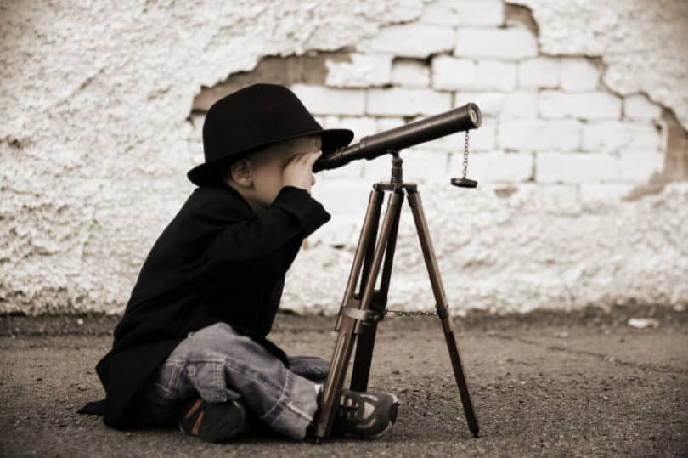
Questions ?

Slide 19
Astronomical Telescope Eyepieces
PowerPoint Created by Richard Cofer

